Slide 1

END SEM PRESENTATION
on
AI MODEL FOR SPACE INVADERS
Team Members
B.SAI ABHISHEK BL.EN.U4AIE21015
B.RUCHITH BALAJI BL.EN.U4AIE21017
CHILLAKURU HARI BL.EN.U4AIE21038
Date:24/05/24
Course :RL
Nippun Sir
AI 6th Sem –E Sec

Slide 2
CONTENTS
Introduction
Problem statement
Literature survey
Research gap
RL Formulation
Methodology
Results
Conclusion

Slide 3
INTRODUCTION
Space Invaders is a renowned arcade game known for its challenging gameplay, making it an ideal platform for testing AI algorithms.
Deep Q-Network (DQN) and Proximal Policy Optimization (PPO) are two prominent RL algorithms known for their ability to learn and optimize strategies through trial and error. DQN utilizes a deep neural network to approximate Q-values, while PPO focuses on directly optimizing policy functions for stable and efficient learning.
The objective of this study is to assess the performance of DQN and PPO agents in mastering Space Invaders. By comparing their average rewards, highest single-episode rewards

Slide 4
Problem Statement
The problem Statement is to build an AI Model for Space Invaders (Atari Games).
The goal is to train the agent to survive for a long time in the Space Invaders game.
Challenges:
Adding Up and Down function to the agent.
Creating Environment
Reducing the time to train the agent Efficiently.
Balancing Exploration and Exploitation.

Slide 5
Literature Survey
MODEL BASED REINFORCEMENT LEARNING FOR ATARI
Łukasz Kaiser , Mohammad Babaeizadeh , Piotr Miłos, Błazej Osi nski ,
This paper was published in 2020.
This study explores the integration of model free learning Search in deep reinforcement learning, focusing on Atari environments.
They created agents that can enable learning in the Atari Learning Environment.
They describe Model free learning based on video prediction models and present a comparison of several model architectures, including a novel architecture that yields the best results in their setting
Their experiments evaluate model on a range of Atari games in low data regime of 100k interactions between the agent and the environment

Slide 6
Literature Survey
Defeating the Invaders with Deep Reinforcement Learning.
Christian L. Martinez-Nieves.
This paper was also published in 2020.
This paper mainly focuses on compare how Deep Q-learning and Deep Deterministic Policy Gradient algorithms proposed.
The DQL algorithm was then implemented. The created DQL agent uses Adam optimizer with 0.001 learning rate and Same with the case of DDPG
They concluded that DQL agent tended to achieve relatively high scores while testing.

Slide 7
RESEARCH GAPS
Traditional implementations of Space Invaders restrict the spaceship's movement to only left and right directions. This simplified action space does not fully utilize the potential complexity and strategic depth of the game.
Our study addresses this gap by extending the action space to include vertical movement, allowing the agent to move both up and down in addition to left and right. This introduces a new dimension to the gameplay, increasing the challenge for the learning algorithms

Slide 8
RL Formulation
Agent: The agent is the player-controlled character whose goal is to maximize its score by shooting down invading aliens while avoiding their attacks.
Environment: The environment represents the game of Space Invaders itself, including the game screen, the aliens, the player's spaceship, and any other elements present in the game.

Slide 9
RL Formulation
State Space: The state space consists of all the information that the agent can observe at a given time step. In Space Invaders, this includes:
The current frame of the game screen, representing the visual input to the agent.
The position and speed of the player's spaceship.
The positions, speed, and types of the aliens on the screen.
The positions and speeds of any bullets fired by the player.

Slide 10
RL Formulation
Action Space: The action space defines the set of actions that the agent can take at each time step. In Space Invaders, the agent can typically perform the following actions:
Move left.
Move right.
Move Up.
Move Down.
Shoot (fire a bullet).
Do nothing (stay still).

Slide 11
RL Formulation
Reward Function: The reward function determines the agent's objective and provides feedback on its actions.
Action | Reward
Every Frame Change | -0.001
Shooting | -0.001
Killing Enemy | 1
Losing Game | -2
Notes:
The game is all about the surviving of the agent in the environment. So, to avoid the agent to be in corners of environment to be safe, the frame change reward is decreased -0.001, So the agent must act like, to fire bullets or to move in environment. The rewards for Shooting a bullet given as -0.001 because if we give a positive or zero reward, the agent tends to shoot to maximize the reward. The reward for killing enemy is 1, so that the agent tries to kill enemies as much as possible. Finally the reward for losing a game is -2, so that the agent tries to survive as much as possible

Slide 12
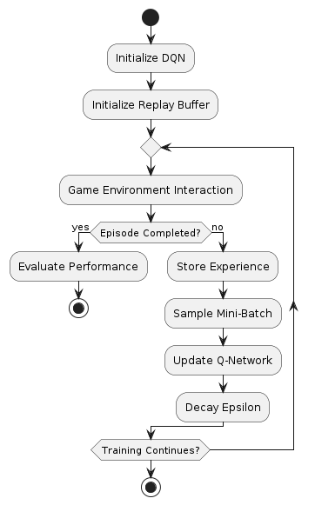
Methodology
Deep Q-Networks (DQN)

Slide 13
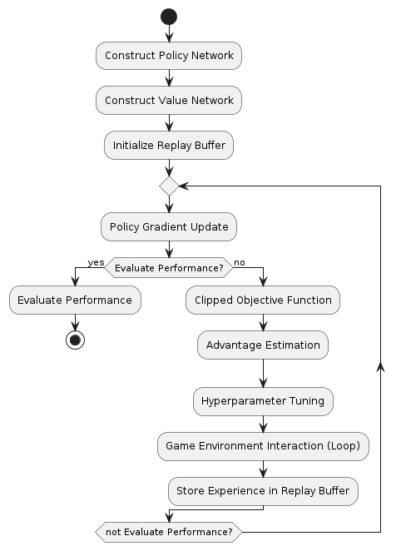
Methodology
Proximal Policy Optimization(PPO)

Slide 14
Methodology
Random Policy

Slide 15
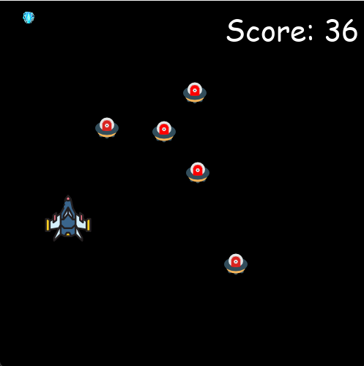
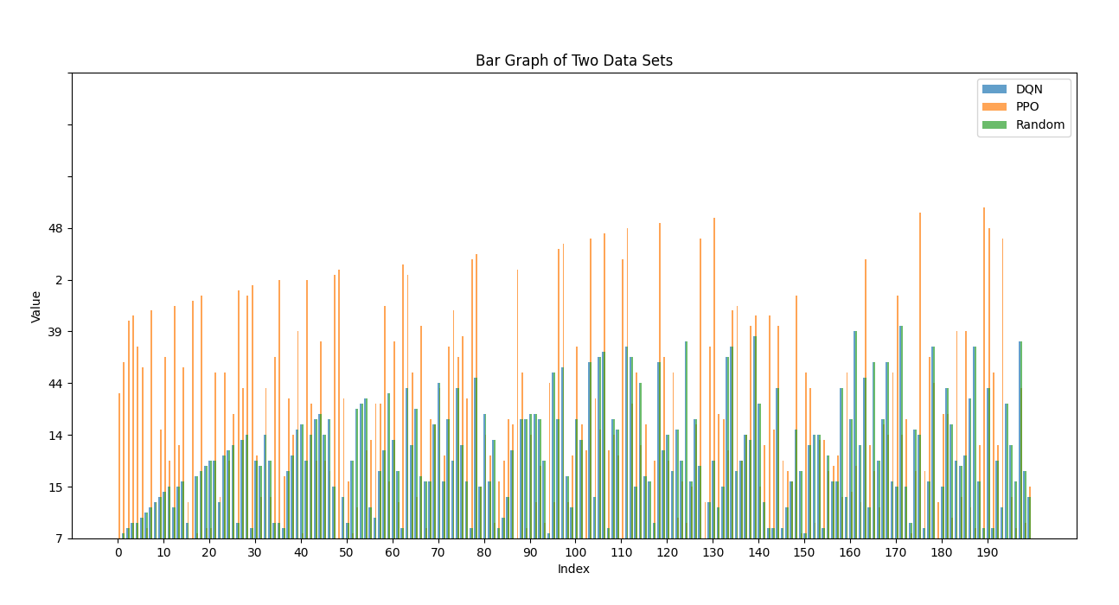
Results
Bar graph of Scores of 3 algorithms
Training the agent.

Slide 16
Results
Algorithm | Learning Rate | Mean reward | Exploration Fraction
DQN | 1e-4 | 15.85 | 0.1
PPO | 0.00025 | 20.831 | 0.025
Algorithm | Episode Number | Average Score | Highest Score
DQN | 200 | 19.85 | 154
PPO | 200 | 24.831 | 175
Random | 200 | 7.454 | 34

Slide 17
Conclusion
PPO significantly outperformed both DQN and the random policy, achieving the highest average reward of 24.831 and the highest single-episode reward of 175, indicating its superior effectiveness in the Space Invaders game.
DQN demonstrated the capability to learn and improve game strategies with an average reward of 19.85 and a highest single-episode reward of 154, though it was less effective than PPO.
The random policy had the lowest performance, with an average reward of 7.454 and a highest single-episode reward of 34, establishing a baseline for comparison and underscoring the advantages of using PPO and DQN for game strategy optimization.

Slide 18
References
Kaiser, L., Babaeizadeh, M., Milos, P., Osinski, B., Campbell, R.H., Czechowski, K., Erhan, D., Finn, C., Kozakowski, P., Levine, S. and Mohiuddin, A., 2019. Model-based reinforcement learning for atari. arXiv preprint arXiv:1903.00374.
Martinez-Nieves, C.L., Defeating the Invaders with Deep Reinforcement Learning.
Singh, A.A., 2022. Deep Reinforcement Learning for Game-Playing Agents.

